Slide 1

Optimizing branch prediction technique

Slide 2

agenda
Why did we choose??
EXISTING branch predictions
Optimized technique
Explanation through an example
conclusion

Slide 3
WHY DID WE CHOOSE??
Control Hazards:
Control hazards is also known as control-flow hazards. These are the crucial concept in computer architecture that significantly impact the performance of a processor.
The disruptions in instruction flow caused by branches or jumps are control hazards. And this leads to the Stalls and affect the performance.
To overcome the above we will use Branch Predictions.
Branch Prediction:
Predict the outcome of branches before known.
These reduces the stalls and improves the instruction throughput in modern process.

Slide 4
Types of branch predictions:
DYNAMIC BRANCH PREDICTION:
1-BIT:
Initialization: Start with a single bit predictor (0,1).
Prediction: If the predictor is 1, predict will be taken; if it is 0, predict the branch will not be taken.
Update: After the branch is resolved(i.e.. The output is known), update the predictor:
If the prediction was correct, leave the predictor unchanged.
If the prediction was incorrect (branch taken but predicted not taken, vice versa) flip the predictor bit

Slide 5
2-Bit:
Initialization: Start with a two-bit saturating counter in a weakly taken state(01).
Prediction: Predict taken if the counter is strongly taken(11 or 10); predict not taken if the counter is weakly taken or not taken(00,01).
Update: After the branch is resolved:
If the prediction was correct and the counter is already at the maximum(11) or minimum(00), leave the counter unchanged.
If the prediction was correct but the counter is not at the maximum or minimum, increment or decrement the counter depending on whether the branch was taken or not taken.
If the prediction was incorrect, flip the two least significant bits of the counter (e.g., 11 to 10, or 00 to 01).

Slide 6
CORRELATING BRANCH PREDICTION:
Predicts the outcome of a branch based on the historical behavior of multiple branches.
Assumes that branches tend to exhibit certain patterns based on their relationships with other branches.
Implementation:
Uses a history table to record the outcomes of multiple recent branches.
Uses the recorded outcomes to predict the behavior of a particular branch.
Prediction process:
The history table stores the outcomes of recent branches as a pattern.
When a branch is encountered, the history table is accessed to determine the likely outcome based on the pattern.
Used in processors with more sophisticated branch prediction mechanisms. Helps improve prediction accuracy for branches with complex relationships.

Slide 7
STATIC BRANCH PREDICTION:
Predicts branch outcomes based on fixed rules or heuristics.
Prediction Strategy:
Always Taken: Predicts that a branch will be taken.
Always Not Taken: Predicts that a branch will not be taken.
Often used as a baseline or fallback strategy.
Suitable for branches with predictable behavior.
Performance impact depends on the predictability of branches in the code.
Static prediction is straightforward and has low overhead, it may not be very accurate for branches whose behavior depends on runtime conditions.

Slide 8
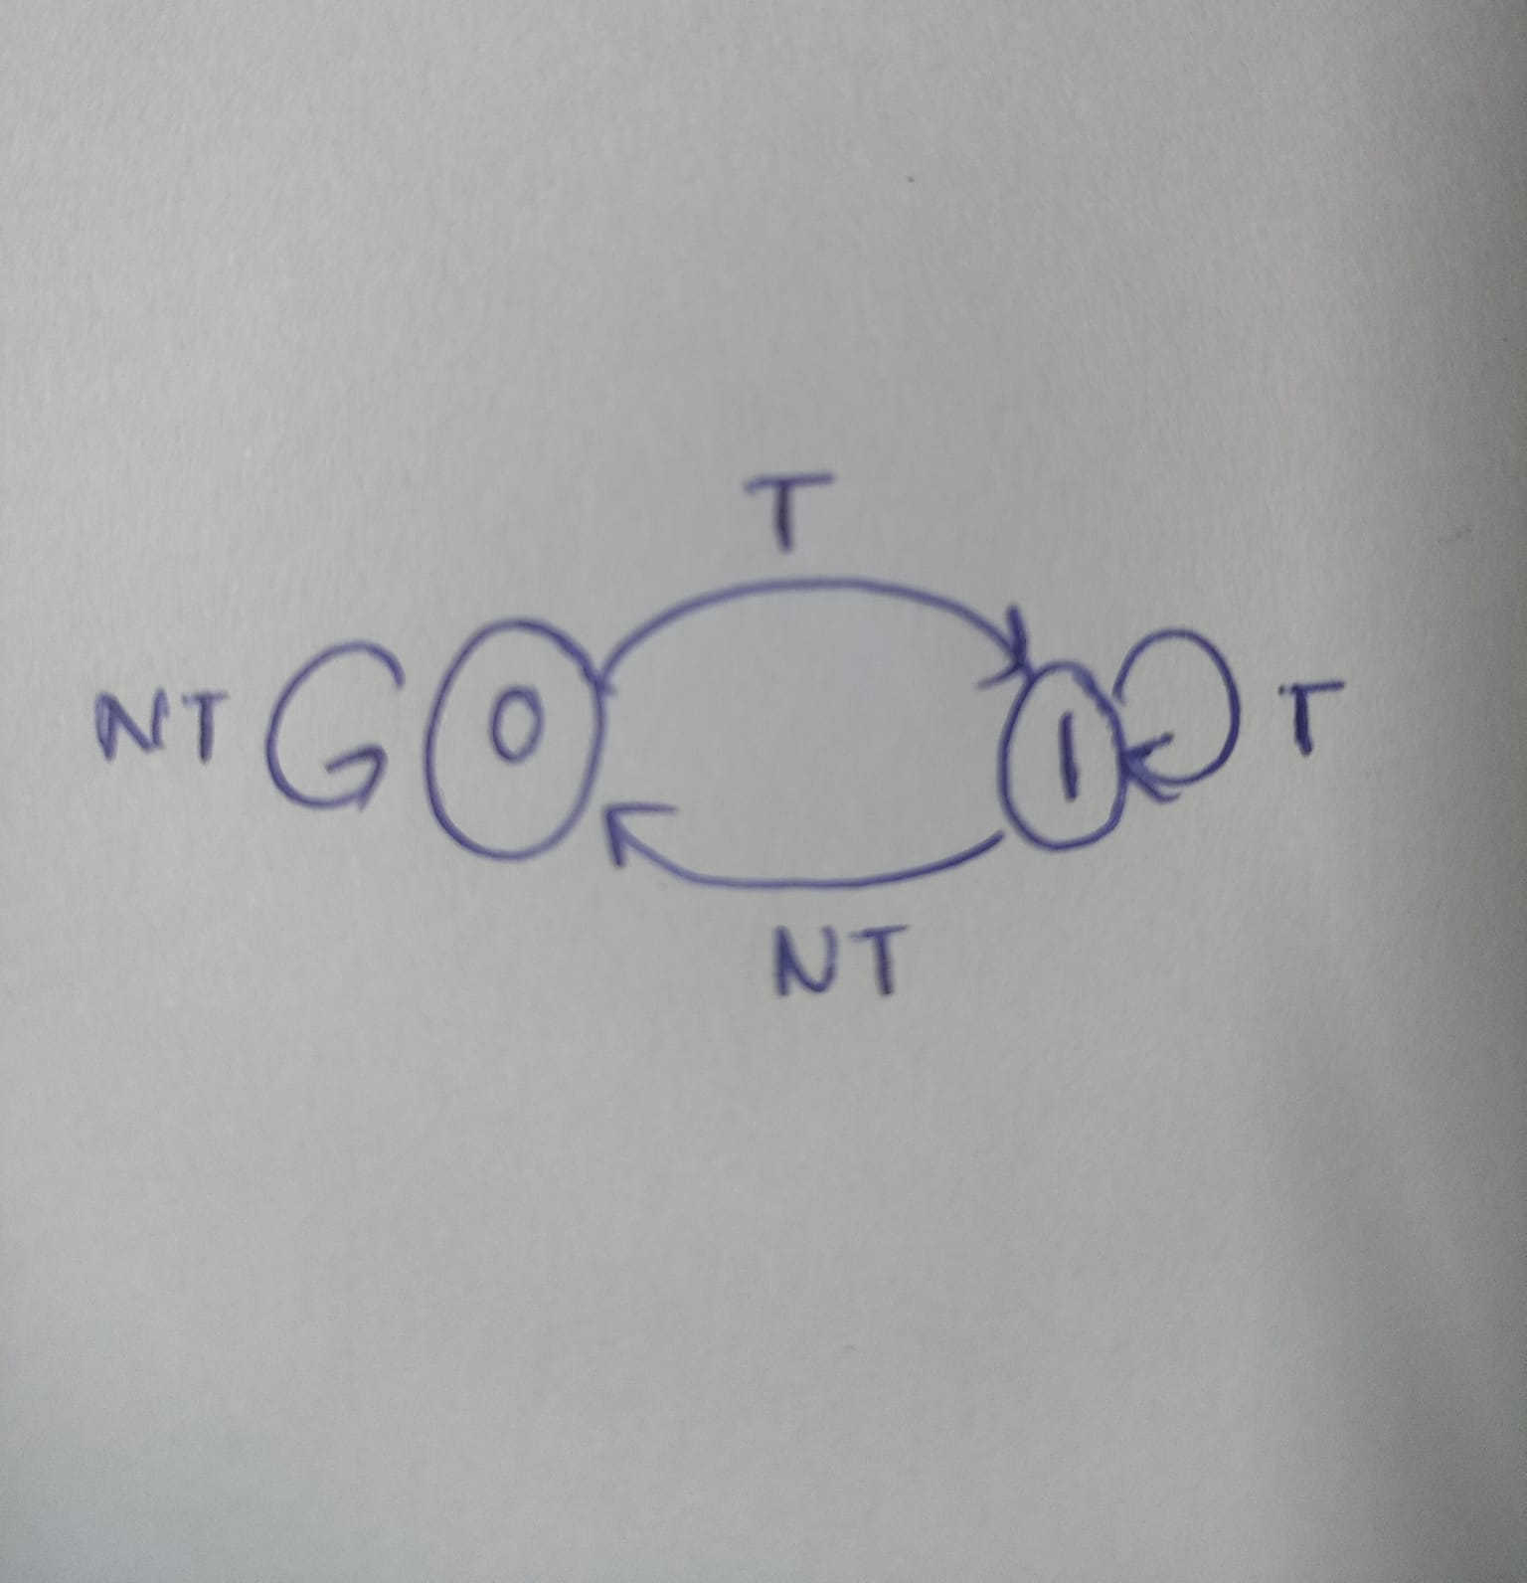
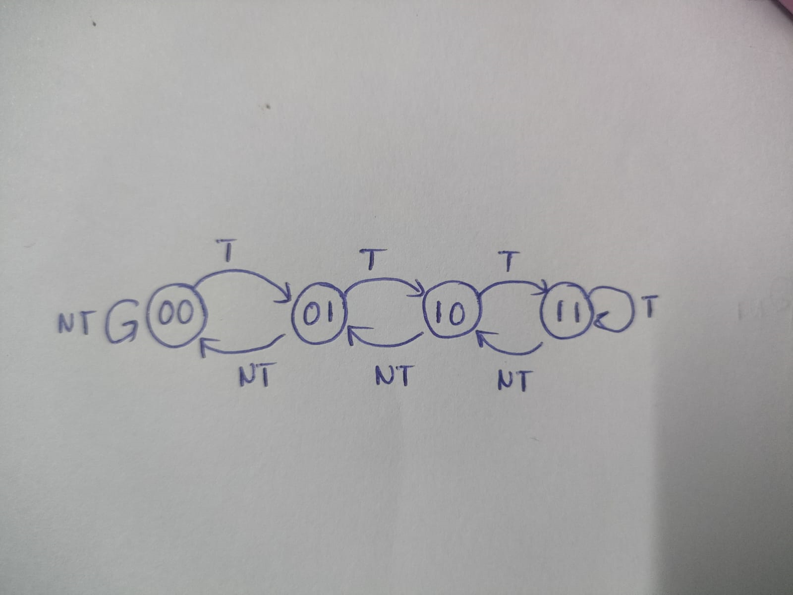
FINITE STATE Automaton(FSA) 1-BIT: 2-BIT:

Slide 9

OPTIMIZED TECHNIQUE

Slide 10
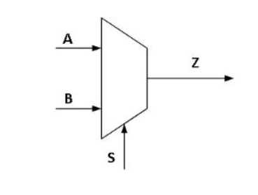
We propose a new optimized technique that leverages a 2x1 multiplexer (MUX), where:
S represents the output from correlating branch prediction.
A represents the output from 2-bit branch prediction.
B represents the output from static branch prediction.
If Z=1 then the branch is predicted to be taken else not taken.

Slide 11
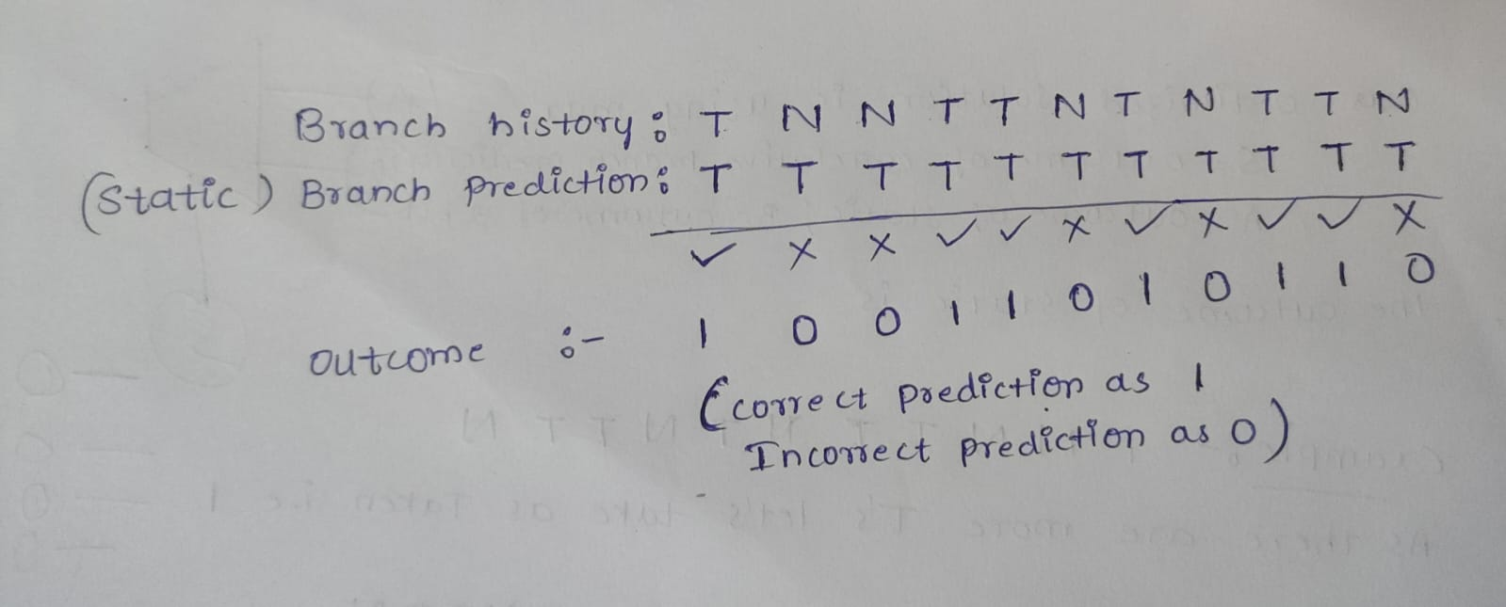
EXAMPLE:
BRANCH PATTERN HISTORY : T N N T T N T N T T N
LET'S CALCULATE THE OUTCOME OF B(STATIC):

Slide 12
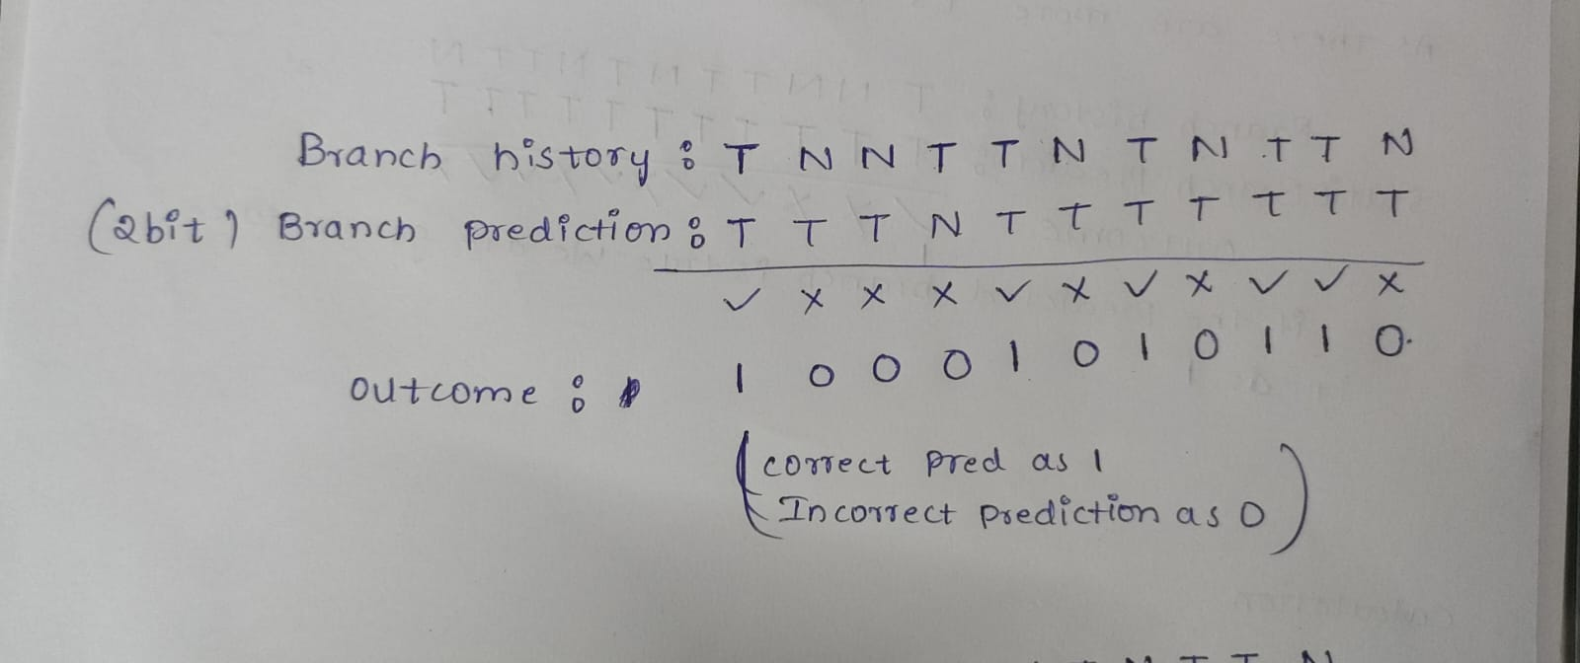
LET'S CALCULATE THE OUTCOME OF A(2-BIT):

Slide 13
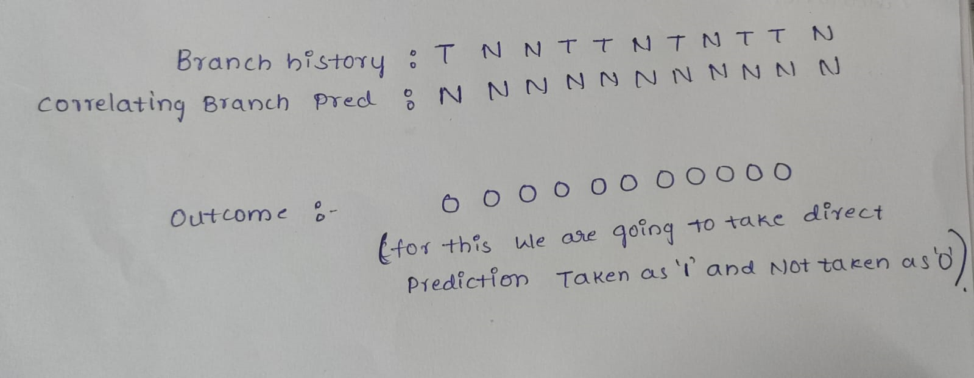
LET'S CALCULATE THE OUTCOME OF S(CORRELATING):

Slide 14
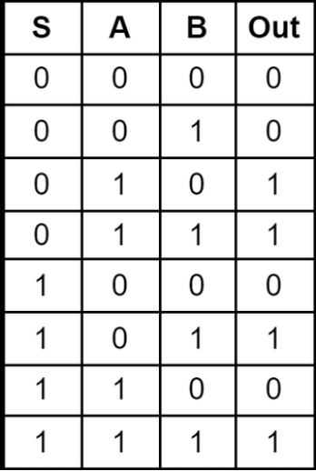
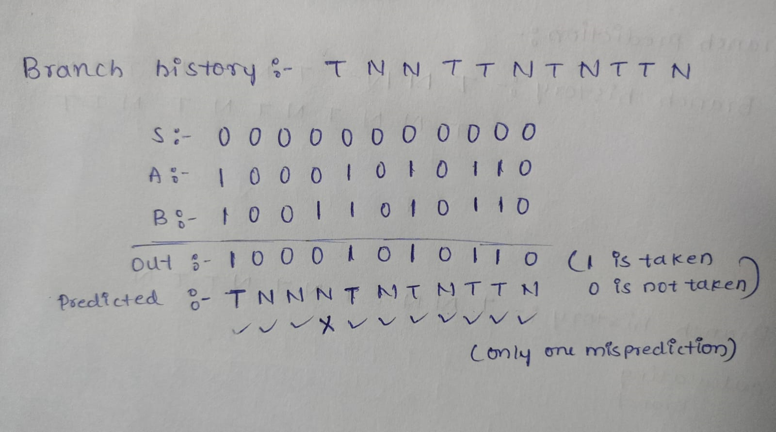
OUTCOME OF OPTIMIZED TECHNIQUE:

Slide 15
COUNT OF MISPREDICTIONS:
1-BIT BRANCH PREDICTION : 7
2-BIT BRANCH PREDICTION : 6
CORRELATING BRANCH PREDICTION : 6
STATIC BRANCH PREDICTION : 5
OPTIMIZED BRANCH PREDICTION : 1

Slide 16
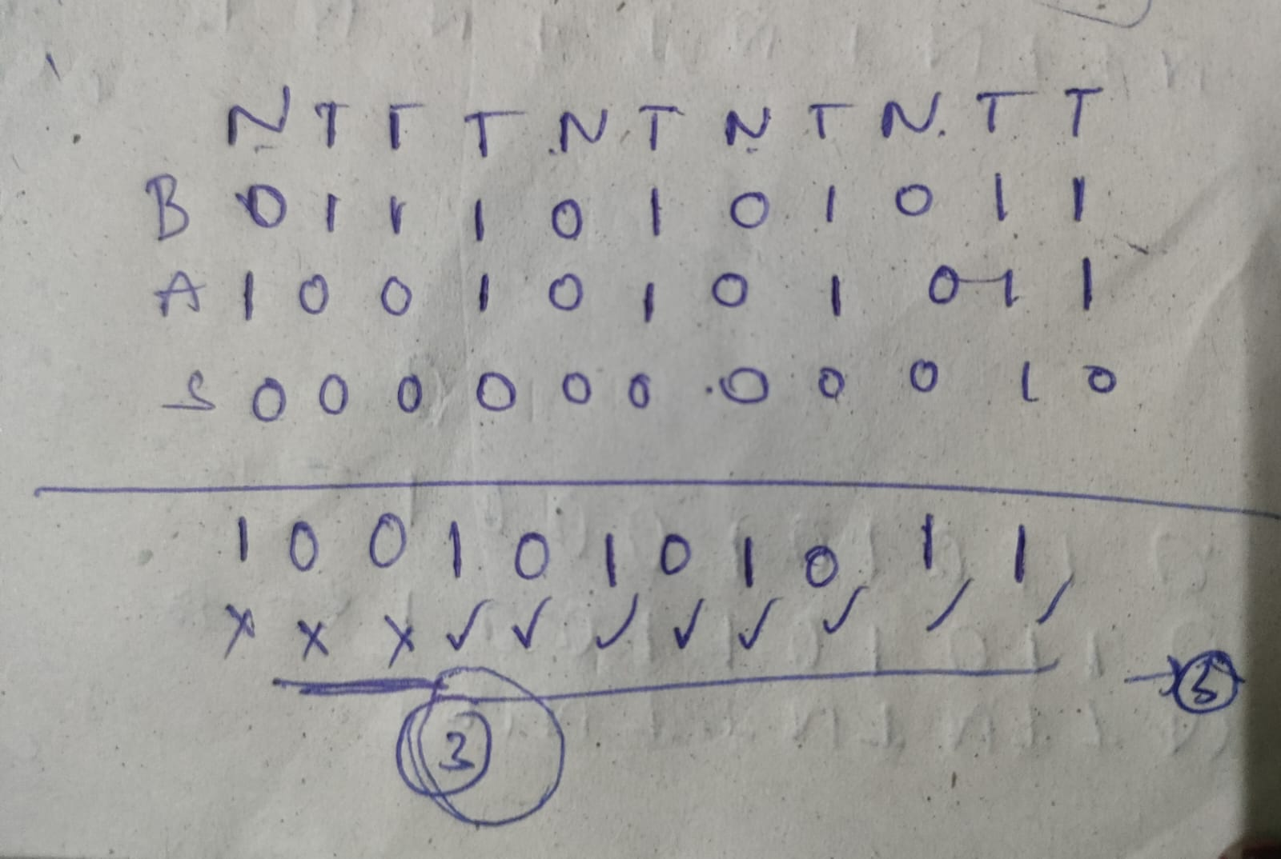
LET'S CHECK FOR ANOTHER EXAMPLE:
BRANCH PATTERN HISTORY : NTTTNTNTNTT
1-BIT MISPREDICTIONS : 7
2-BIT MISPREDICTIONS : 5
CORRELATING MISPREDICTIONS : 6
STATIC MISPREDICTIONS : 4
OPTIMIZED METHOD MISPREDICTIONS : 3

Slide 17
CONCLUSION:
Through the MUX, our technique dynamically chooses the most accurate prediction enhancing overall prediction accuracy and efficiency.

Slide 18

THANK YOU
N.PRIYADARSHINI (CS22B1009)
G.SATYA PRIYA (CS22B1012)
K.SRI HARSHA PRIYA(CS22B1017)

